Slide 1
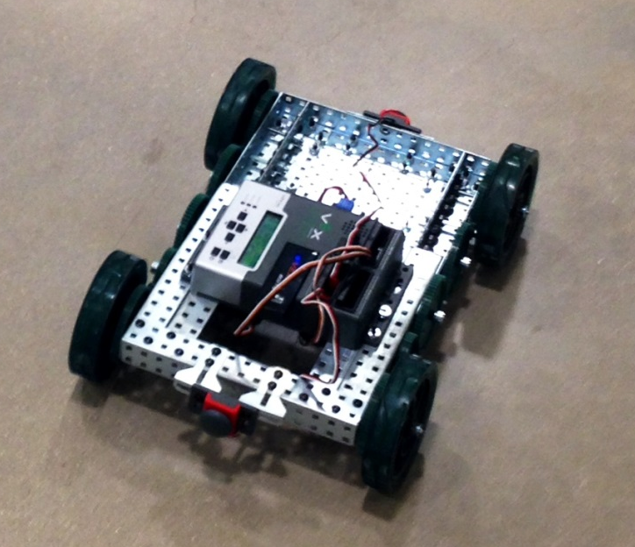
Harold’s Mechanics
Embedded Systems Fall 2013
Iteration 2
Jenny Reiman
Jason Laqua
Andrew Kirkham

Slide 2

Problem Statement
Entire Project: The objective of this project is to build and drive a robot around the central mall by using GPS programmed coordinates through a wireless connection to android devices.

Slide 3
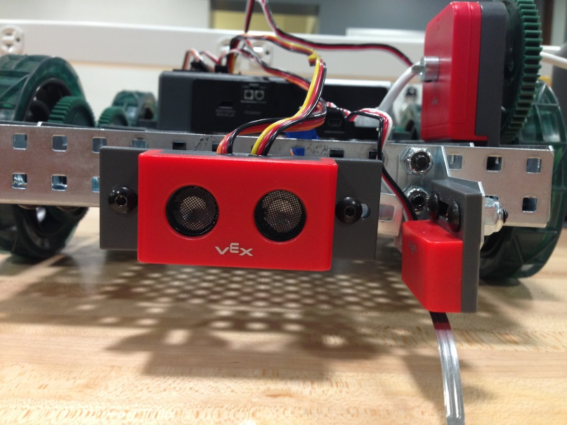
Problem Statement
Iteration 2: The goals of this iteration involved creating the Android UI, receiving GPS coordinates and driving the robot to them, integrating 3 sensors, avoiding cliffs, and driving in a straight line

Slide 4

What was done
Android UI created
Communication was set up between the tablet, phone, and the VEX
Limit sensor added to avoid cliffs
Ultrasonic and bump sensors protect the robot from driving into objects
GPS locations
Forward Fix

Slide 5

What Worked
Limit Sensor
Bump Sensor
Communication
Ultrasonic sensor
GPS location

Slide 6

What Didn’t Work
Optical encoder
Retrieving heading
USB powered VEX
Limit sensor with cracks

Slide 7
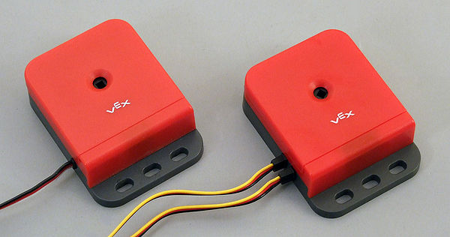
Lessons Learned
Outputs don’t work with USB power
Encoders are currently implemented as quad encoders
Finding outdoor power outlets and testing outside is challenging

Slide 8

Questions?

